Slide 1

Campaign on
CLEAN NATURE - CLEAN NATION

Slide 2


Slide 3
Organised by
A Nationwide Campaign
Scientists & Engineers Wing ( RE&RF)
Brahma Kumaris

Slide 4
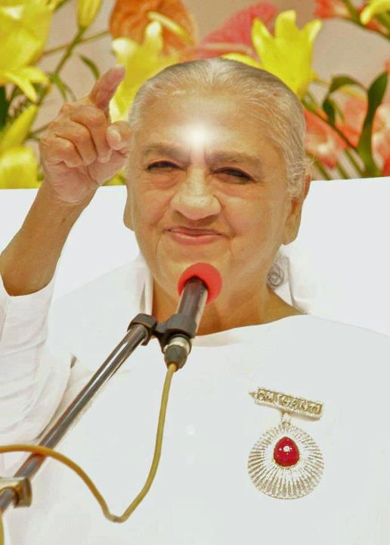
Background
The world is especially interested in research about the stars of the sky, and these stars have an influence on the earth. But you are the stars of the earth, who fill the world with purity, happiness, and peace. You protect the world from upheaval, and create a happy world, a golden world. At present both nature and human beings are creating upheaval and chaos in the world. You stars of the earth fulfill the desires of all souls by being the embodiment of attainment.
Avyakt Bapdada,08-01-86
( Supreme Father of All Souls )

Slide 5
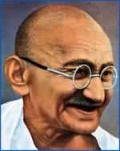
Background
Since we are conscious of ourselves as souls, our cleanliness must be both internal and external. If we are neat and tidy outwardly but have unclean minds, we make a false show or are guilty of pure hypocrisy .
M.K. Gandhi,16-01-1936

Slide 6

Background
Clean Indian Mission (Swachh Bharat Abhiyan) is a national level campaign by the Government of India to clean the infrastructure of the country.
This campaign aims to accomplish the vision of 'Clean India' by 2 October 2019, 150th birth anniversary of Mahatma Gandhi and is expected to cost over INR 62000 crore.

Slide 7

Our Model of Clean Nation
Character
Lifestyle
Energy
Action
Nature

Slide 8
Nature- Outer and Inner
Pure Thought
Inner Nature
CLEAN NATION
Mother Nature

Slide 9
Objectives
To create awareness about the interconnectedness of Nature
To motivate people about cleanliness-both inner and outer
To inspire people about our ancient wisdom for environmental protection
To sensitize people about health hazards because of uncleanliness
To focus on personal responsibility for a clean surrounding
To build a culture of ‘ Simple Living , Subtle Thinking’ towards sustainable system

Slide 10

Organize different awareness programmes
Collaboration with other NGOs
Programmes on relevant topics at special days like- world Earth Day ( 22 April ), World Environment Day ( 5th June ) at different places

Slide 11

Make people aware about the health issues because of uncleanliness
Collaboration with Industries and Govt. Bodies as part of CSR activities
Special Yoga for inner cleanliness follows every programme

Slide 12

“Special Website ” – to be Launched www.cleannaturecleannation.in
It is where resources for conducting programmes, presentations, brochures will be loaded which our centres can download

Slide 13

Additional Features

Slide 14
Campaign Stewards – for each zones / sub zones to co-ordinate the event .
Proposal to conduct National Level Seminars at Vigyan Bhawan and other such bodies
Unique Picture exhibition to be prepared on the theme
Special Pledge form to be filled on 8 Practical Steps that has been prepared.

Slide 15


PLEDGE
Lets all commit to Clean Nature- Clean Nation .
PLEDGE
Notes:
Cleanliness is next to Godliness.

Slide 16

And it begins with personal responsibility.. Making A beautiful India is my responsibility …

Slide 17
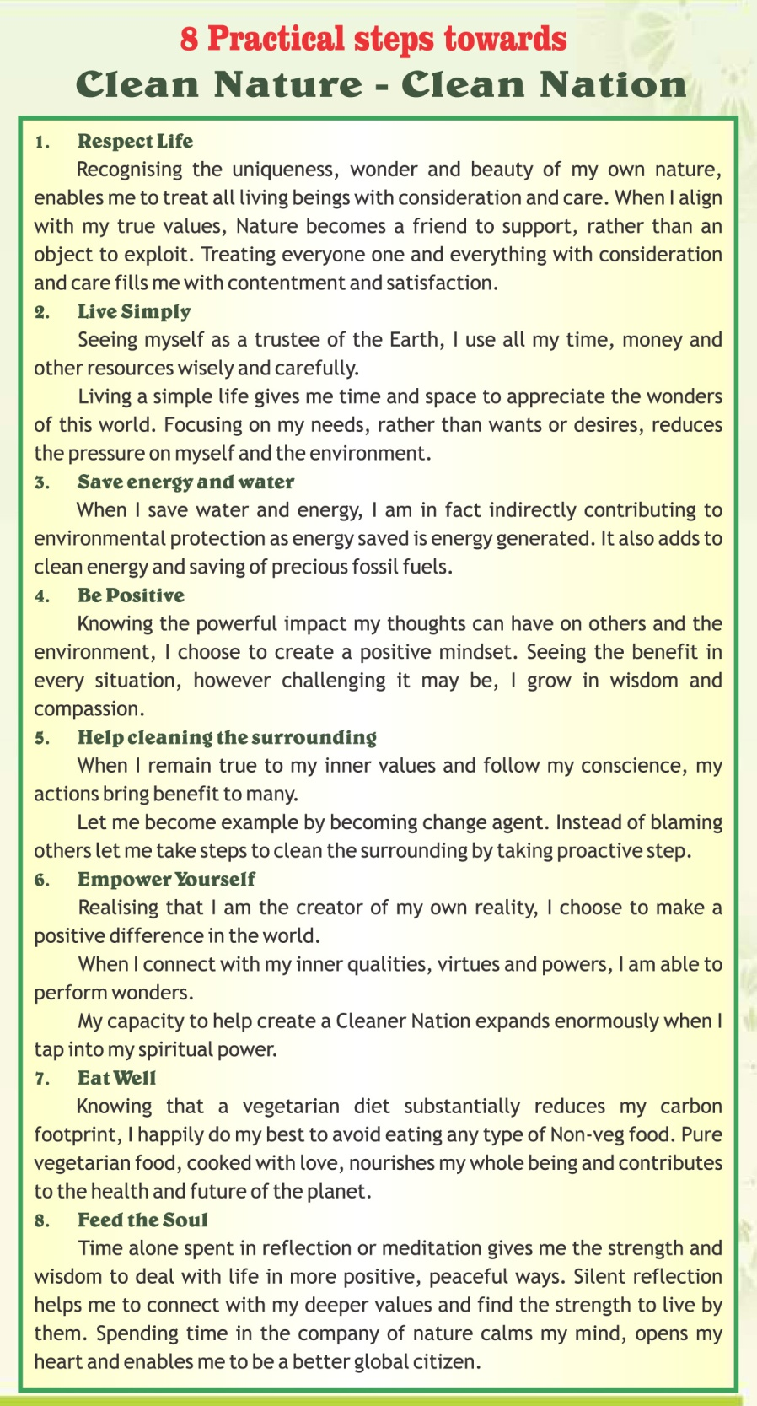

Slide 18

Your further input welcome..

